Slide 1
Introduction to Spring Framework
Authored by : Sangeeta Joshi Presented by: Sangeeta Joshi

Slide 2
Agenda
Spring Fundamentals
What is IOC?
Bean factory and scope
Contexts and bean life cycle

Slide 3
Spring
Spring is a lightweight dependency injection and aspect-oriented container and framework
Spring is a Container as it creates the Java Components for your application and manages their life-cycle
It is lightweight in terms of size and overhead.
It can be distributed in a single JAR file and Java components running inside Spring container often have NO dependency on Spring specific Classes and Interfaces. ( Plain Old Java Objects –POJO )

Slide 4
What is Spring?
It is an application framework unlike single tire framework like hibernate, struts.
It’s the only framework to address all architectural tiers of typical j2ee application
It also offers a comprehensive range of service as well as lightweight container

Slide 5
What Does Spring Do?
Lightweight Inversion of Control Container, D/I Container)
  A way to manage all of your application objects
Aspect Oriented Programming Framework
JDBC Abstraction Layer
  Make database programming easy with less effort
JPA / Hibernate / JDO / iBATIS Abstraction Layer
  Make object relational persistence easy with less effort
Transaction Management
  Provide a way for transaction management without using EJB container
Web Framework
  Lightweight web application framework
  Web-based workflow engine

Slide 6
Spring framework goals
Make developing enterprise applications easier
Promote programming to Interfaces
Reduce application complexity
Loose coupling
  Objects should not depend on Spring APIs
  Objects should not implementing Spring Interfaces
  Objects should not sub-classes Spring object
  Your existing application should easily be able to take advantage of Spring!
Do not compete with existing solutions
  Integrate with other best-of-breed solutions!

Slide 7
What is IOC?
Inversion of Control/Dependency Injection
Inversion of Control(Dependency Injection )
  Let something else (an assembler) manage the interaction of the objects in your system!
  Hollywood Principle: “Don’t Call Us… We’ll Call You!”
  Spring is a dependency injection container!

Slide 8
Advantages of IOC/DI
Avoid adding lookup code in business logic
Promotes a consistent approach across all applications and
teams
Simplifies unit testing
Allows reuse in different application environments by changing configuration files instead of code

Slide 9
Dependency Injection and Spring
Spring provides a framework for managing object dependencies and initializing / configuring objects.
Through XML, we will let spring know about our objects and what their dependencies are.
Spring will make sure that the objects are initialized and configured`

Slide 10
Dependency Injection and Spring
Spring works with JavaBeans.
JavaBeans is a coding standard that adheres to the following principles:
  Objects have a public, no argument constructor
  “set” methods are used to set object properties
  “get” methods are used to get object properties
  4. Setters and getters adhere to a naming convention:
    getPropertyName
    setPropertyName

Slide 11
Dependency Injection
Types of Dependency Injection:
1. Setter Injection
2. Constructor Injection
3. Method injection
No special code to resolve the dependencies
No special interfaces to implement
A Dependency Injection Container (like Spring) will actually
construct and configure the dependencies for us!

Slide 12
Dependency Injection
The IOC container will Inject the dependencies in three ways
  Create the POJO objects by using default constructors and injecting the dependent properties by calling the setter methods.
  Create the POJO objects by using parameterized constructors and injecting the dependent properties through the constructor.
  Implements the method Injection.

Slide 13
Dependency Injection
Setter injection
  Dependencies are set by the calling setter methods on an object. The Container will call the setter methods and configure/instantiate the object for you.
class MovieLister{
Finder finder;
  public void setFinder(MovieFinder finder) {
  this.finder = finder;
  }
  <bean id="MovieLister" class="MovieLister">
  <property name="finder">
  <ref local=" finder "/>
  </property>
  </bean>
  Note: No special initialization logic. The container will handle the initialization for us!

Slide 14
Dependency Injection
Constructor Injection
  Dependencies are set by the Object Constructors. The Container will call the constructor and configure and instantiate the object for you.
public class MovieLister{
  private Finder finder
  public void MovieLister(Finder finder) {
  thisfinder = finder;
  }
}
  <bean id="MovieLister" class="MovieLister">
  <constructor-arg><ref bean="anotherExampleBean"/></constructor-arg>
  </bean>

Slide 15
Bean Definition
  Name : Implementation class name of the bean
  Behavior : Configuration behavioral elements (singleton / prototype I.e. non-singleton , wiring mechanism & life cycle) the bean that should behave in the container
  State : The constructor arguments and the property values that defines or collaborates with other beans
  <?xml version="1.0" encoding="UTF-8"?>
  <!DOCTYPE beans PUBLIC "-//SPRING//DTD BEAN//EN" "http://www.springframework.org/dtd/spring-beans.dtd">
  <beans>
  <bean id = “exampleBean” class =“examples.ExampleBean”>
  </bean>
  <bean id = “anotherExample” class =“examples.AnotherExampleBean” scope=“singleron”>
  </bean>
  <beans>

Slide 16
Beans Scope
By default all beans in Spring are singletons. That is there will be a single instance of a bean per factory
Singletons are great for stateless objects such as service layer objects, data access objects, web controllers
Things to Consider
- Spring can manage lifecycle
- No instantiation overhead
- Need to be aware of multithreading
<bean id=“person1” class=“…”>
<bean id=“person1” class=“…” scope=“singleton”>

Slide 17
SPRING MODULES
The core container
Provides the fundamental functionality of the Spring Framework containing the BeanFactory, which is the fundamental Spring container and the basis on which Spring’s DI is based
Application context module
Built on the core container making Spring a Framework
Provides support for i18n, application life cycle events and validation
Provides enterprise services such as email, JNDI access, EJB integration

Slide 18
Spring Modules
AOP module
-This module serves as the basis for developing your own aspects for your Spring enabled application
-With AOP, application-wide concerns (such as transactions and auditing) are decoupled from the objects to which they are applied
JDBC abstraction and the DAO module
-It abstracts away the common code like opening and closing connections, so that you can keep your database code clean and simple

Slide 19
Spring Modules
Object-relational mapping (ORM) integration module
-Built on top of DAO module
-Spring doesn’t attempt to implement its own ORM solution, but does provide hooks into several popular ORM frameworks, including Hibernate, JPA and iBATIS
The Spring MVC framework
-Spring comes with its own MVC framework and even it can integrated with existed popular MVC frameworks like Struts, JSF, and Tapestry

Slide 20
Sometimes you want to retrieve a new instance of a bean when retrieving it from the factory
Need to specify a scope of prototype
Things to consider
thread-safe
instantiation occurs on each request
lifecycle not managed by Spring
<bean id=“person1” class=“…” scope=“prototype”>

Slide 21
Bean Factory
A BeanFactory is an implementation of the Factory design pattern.
Implementation class object will load bean definitions stored in a Configuration Source (such as XML) and configure the beans.

Slide 22
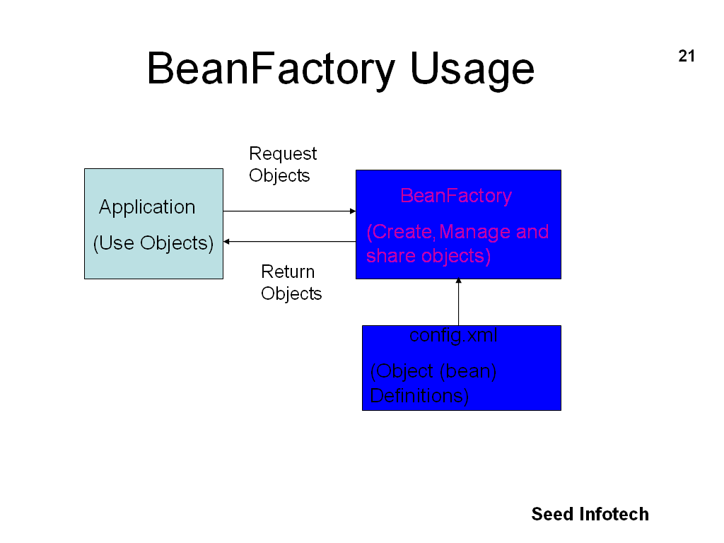

Slide 23
Bean Defination
bean : The Element which is most basic configuration unit
in Spring. It tells Spring Container to create an Object.
id : The Attribute which gives the bean a name by which
it will be referred to in the Spring Container.
class : The Attribute which tells Spring the type of a Bean.
The configuration file named employees.xml
<?xml version="1.0" encoding="UTF-8"?>
<beans>
<bean id="emp" class="com.emp.Employee">
</bean>
</beans>

Slide 24
//Create the Resource of type FileSystemResource to locate xml file
Resource resource = new FileSystemResource("beans.xml");
//create the beanFactory object from xml resource
BeanFactory factory = new XmlBeanFactory(resource);
//request the “CalculatorService” object with id=“service1” from BeanFactory
CalculatorService cs1=(CalculatorService)ctx.getBean("service1");
after getBean(), the factory will instantiate the bean and set the bean’s properties using DI. The object cs1 will be
destroyed by the BeanFactory when it’s scope ends

Slide 25
Resources | Purpose
FileSystemResource | It is retrieved from the FileSystem.
InputStreamResource | It is retrieved from an InputStream.
ByteArrayResource | Contents are given by array of bytes.
ClassPathResource | It is retrieved from the Classpath.
UrlResource | It is retrieved from the given URL.
ServletContext Resource | A resource that is available in Servlet Context.

Slide 26
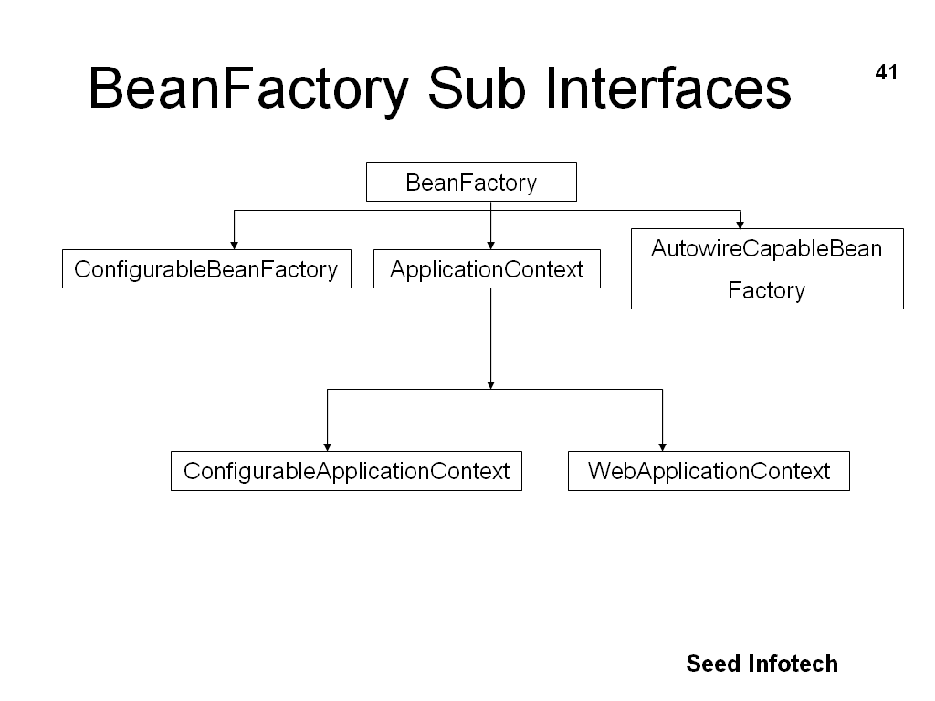

Slide 27
Application Context
The Interface ApplicationContext extends from BeanFactory
  standardizes the bean container for J2EE application context such as web applications.
To build application in a J2EE environment, one should use implementation of ApplicationContext as it supports additional features like
  Means for resolving text messages, including support for i18n.
  Ability to publish events to beans that are registered as listeners.

Slide 28
Application Context
ClassPathXmlApplicationContext
  Loads a context definition from an XML file located in the classpath, treating context definition files as classpath resources
FileSystemXmlApplicationContext
  Loads a context definition from an XML file in the file system
XmlWebApplicationContext
  Loads context definitions from an XML file contained within a web application

Slide 29
Application Context
//Create the Context of type FileSystemXmlApplicationContext to locate xml file
ApplicationContext context = new
FileSystemXmlApplicationContext(“beans.xml”);
//request the “CalculatorService” object with id=“service1” from Context
CalculatorService cs1=(CalculatorService)context.getBean("service1");

Slide 30
Beans Life Cycle Events
You can hook into 2 Bean Life Cycle Events:
  Initialization – after a bean has been instantiated and
  initialized
  2. Destruction – after a bean has bean destroyed

Slide 31
Beans Life Cycle Events
Bean Initialization – 2 options
Implement the InitializingBean interface
public class ExampleBean implements InitializingBean {
  public void afterPropertiesSet() {
  // do some stuff here
  }
  }
2. Or declare your init method in XML
<bean id=“…” class=“…” init-method=“init”>

Slide 32
Beans Life Cycle Events
Bean Destruction – 2 options
Implement the DisposableBean interface
  public class MyBean implements DisposableBean {
public void destroy() {
// do some stuff here
}
}
2. Or declare your destroy method in XML
<bean id=“...” class=“…” destroy-method=“destroy”>

Slide 33
Application Context
ApplicationContexts: a subclass of BeanFactory
For most scenarios, almost all user code does not have to be aware of the BeanFactory.
However BeanFactory does have to be instantiated somehow.
This can happen via explicit user code such as:
  Resource res = new FileSystemResource("beans.xml");
    XmlBeanFactory factory = new XmlBeanFactory(res);
    Factory.getBean(“beanName”)
  ClassPathResource res = new ClassPathResource("beans.xml");
  XmlBeanFactory factory = new XmlBeanFactory(res);
  Factory.getBean(“beanName”)
  3. ClassPathXmlApplicationContext appContext = new ClassPathXmlApplicationContext(
  new String[] {"applicationContext.xml", "applicationContext-part2.xml"});
  // of course, an ApplicationContext is just a BeanFactory
  BeanFactory factory = (BeanFactory) appContext;
  Factory.getBean(“beanName”)

Slide 34
Bean LifeCycle
Populate
Properties
BeanNameAware's
setBeanName()
Instantiate
BeanFactoryAware's
setBeanFactory()
ApplicationContextAware's
setApplicationContext()
InitializingBean's
afterPropertiesSet()
Call Custom init-method
DisposableBean's
destroy()
Call Custom
destroy-method

Slide 35
Bean Lifecycle
Instantiate
  Spring instantiates the bean
Populate properties
  Spring injects the bean’s properties
Set bean name
  If the bean implements BeanNameAware, Spring passes the bean’s ID to setBeanName()
Set bean factory
  If the bean implements BeanFactoryAware, Spring passes the bean factory to setBeanFactory()
Postprocess (before initialization)
  If there are any BeanPostProcessors, Spring calls their postProcessBeforeInitialization() method

Slide 36
Initialize beans
  If the bean implements InitializingBean, its afterPropertiesSet() method will be called
  If the bean has a custom init method declared, the specified initialization method will be called
Postprocess (after initialization)
  If there are any BeanPostProcessors, Spring calls their postProcessAfterInitialization() method
  Bean is ready to use and will remain in the bean factory until it is no longer needed
Destroy bean
  If the bean implements DisposableBean, its destroy() method will be called
  If the bean has a custom destroy-method declared, the specified method will be called

Slide 37
Bean scope
The Bean creation can be controlled in following manner:
  Control how many instances of a specific bean are created, whether it is one instance for the entire application, one instance per user request, or a brand-new instance each time the bean is used.
  Create beans from static factory methods instead of public constructors.
  Initialize a bean after it is created and clean up just before it is destroyed.

Slide 38
Bean Scope
Scope Value | Meaning
singleton | Only single instance of bean is created inside Spring Container
prototype | Instance of Bean will be created once per use
request | Scopes a bean definition to an HTTP request (only valid in Spring MVC)
session | Scopes a bean definition to an HTTP session (only valid in Spring MVC)
global-session | Scopes a bean definition to a global HTTP session (Only valid when used in a portlet context)

Slide 39
Auto wiring
Rather than explicitly wiring all of your bean’s properties, you can have Spring automatically figure out how to wire beans together by setting the autowire property.
Spring provides four types of autowiring:
  byName
    Attempts to find a bean in the container whose name (or ID) is the same as the name of the property being wired. If a matching bean is not found, the property will remain unwired.
  byType
    Attempts to find a single bean in the container whose type matches the type of the property being wired. If no matching bean is found, the property will not be wired.

Slide 40
  Constructor
    -Tries to match up one or more beans in the container with the parameters of one of the constructors of the bean being wired.
  Autodetect
    -Attempts to autowire by constructor first and then using
    byType.

Slide 41
Java E E Vs Spring
JAVA E E
Heavyweight application server having server centric architecture
Components inside container must implement specific interfaces and mandates inheritance hierarchy
Components must be tested within container only, thus testing can be difficult to set up
The cycle of “build, unit-test, deploy, integration-test” can be time taking
SPRING
Lightweight framework WITHOUT server centric architecture
Components are simple POJO objects which can be resused outside Spring framework as well
POJOs created can be easily unit tested outside any complex container
The build-and-unit-test cycle can be decoupled from container and integration cycle is improved because of POJO centric design of beans

Slide 42
Any Questions?

